Slide 1

Introduction to Robotics
2016 Fall

Slide 2
Project Roadmap
Class | Date | Project | Finished?
1 | 9/06/16 | Introduction of Robot and Robotics, mBot Assembly | yes
2 | 9/13/16 | Introduction of mBlock | yes
3 | 9/20/16 | Play an Octave | yes
4 | 9/27/16 | Push a Button | yes
5 | 10/04/16 | Light Sensor, UltraSonic Sensor | yes
6 | 10/11/16 | Drive with Remote, Line Following | yes
7 | 10/18/16 | Robot Movement 1 | yes
8 | 10/25/16 | Robot Movement 2, Trace a Shape | yes
9 | 11/01/16 | Obstacle Avoidance | yes
10 | 11/08/16 | Sumo Wrestling 1
11 | 11/15/16 | Sumo Wrestling 1
12 | 11/22/16 | Maze 1
13 | 11/29/16 | Maze 2
14 | 12/06/16 | C Programming 1
15 | 12/13/16 | C Programming 2

Slide 3
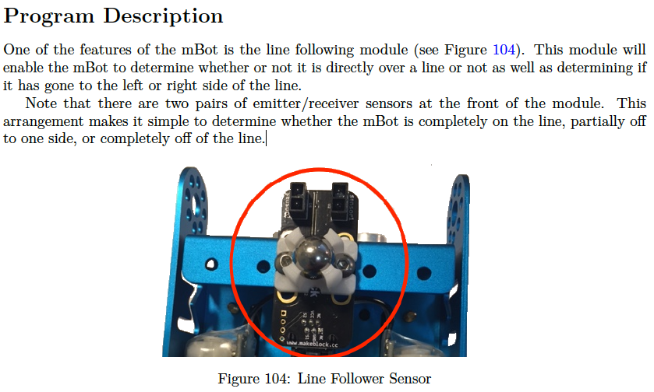
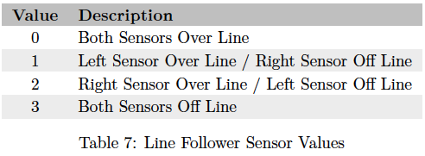
Line Follower Sensor

Slide 4
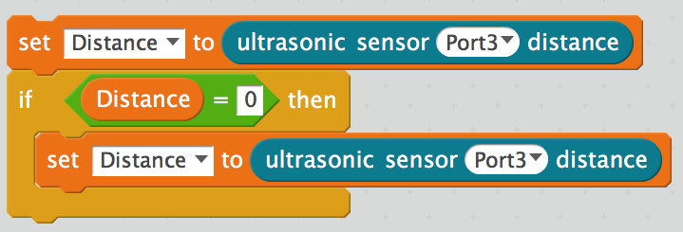
Ultrasonic Sensor: Read distance from object in front

Slide 5
Sumo Wrestling
https://www.youtube.com/watch?v=dyA4kW-Y5rE
Robot moves inside the ring.
Push the opponent outside the ring.
mBots
Ring (20-30 inches)

Slide 6
Requirements
1. The robosumo mat shall be circular with a minimum interior diameter of 24 inches (~61cm).
2. The mBot shall be able to move around within the confines of a ring.
3. The mBot shall be capable of detecting the edge of the ring.
4. The mBot shall be able to execute an avoidance strategy to stay within the ring when a ring
edge is detected.
5. The mBot shall be able to locate an opponent.
6. When an opponent is located, the mBot shall charge at the opponent and attempt to push the opponent from the ring.
7. The mBot shall have the capability to stop movement after the round duration has expired.

Slide 7
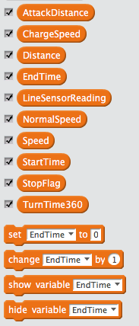
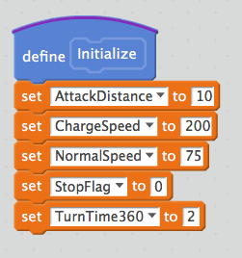
Implement: Variables and Initialization
Attack if distance is >0 and < AttackDistance
Speed to charge to the opponent
Distance to the opponent
Time to quit
Line Sensor reading
Navigating speed
Not needed
Starting time
Time needed for a 360 degree turn

Slide 8
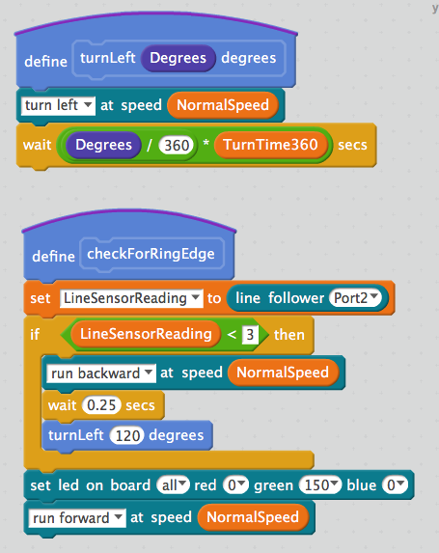
Implement: Detect the Ring Edge
If the line follower reading is 0, 1, or 2:
1. move backward 0.25 sec
2. make 120 degree left turn
3. continue to move forward

Slide 9
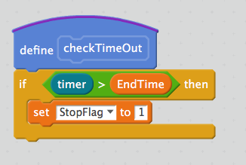
Implement: Track the Time
If current time is more than expected session time:
1. set Stop Flag to 1 to quite the program

Slide 10
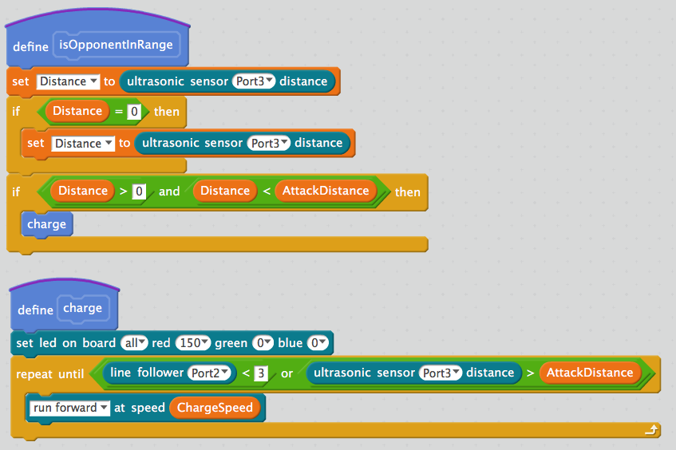
Implement: Detect the Opponent and Charge
If the opponent is found and close enough, charge to push the opponent out of the ring.

Slide 11
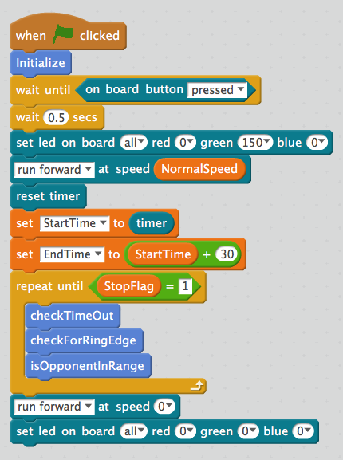
Implement: Main Program Logic
Initialize variables
Press the button to start
Start navigating
Setup the timer
Set the Stop Flag to 1 if time to quit
Stay inside the ring
Detect the opponent; charge if found
Stop the robot

Slide 12
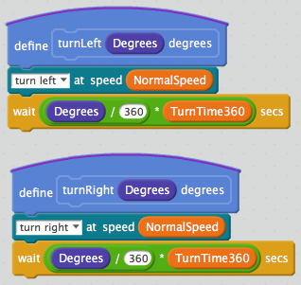
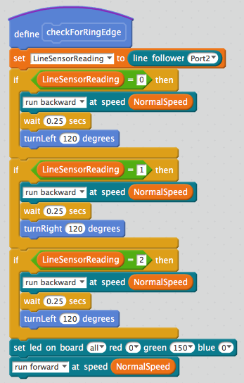
Improvement 1: Stay in the Ring

Slide 13
Improvement 2: Add Brackets to make a BattleBot

Slide 14
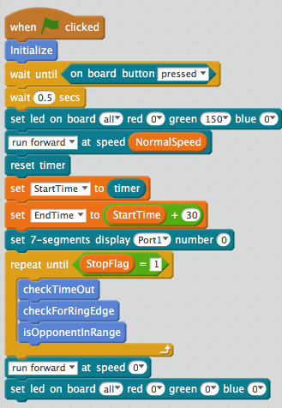
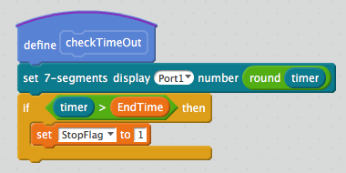
Improvement 3: Add Display to Display Time

Slide 15
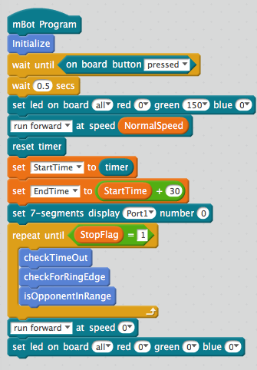
Improvement 4: Upload to make it ready to fight

